Slide 1
FuelMart & Subway Safety Committee Meeting
Wednesday, May 15, 2019
2:00 PM
Corporate Office Conference Room and GoTo Meeting Web Conference

Slide 2
1. Safety Topic – Utility Knives (Box cutters) safety tips 2. FuelMart documents website has been updated and includes PowerPoint, Meeting minutes and the recording. 3. No Open items
April 2019 Review:

Slide 3
Incidents and Injuries From 04/17/2019 to 05/12/2019

Slide 4
Employee Injuries:
No new reported employee injuries since our last safety committee meeting. Great Job!
Last employee reported injury was on 04/15/2019. Subway employee using tomato slicer. Employee went to pick up a piece of tomato that fell by the blades and bumped a blade causing a cut to the finger. Corrective Action – Employee should have been wearing cut resistant gloves. Employee was re-trained.

Slide 5
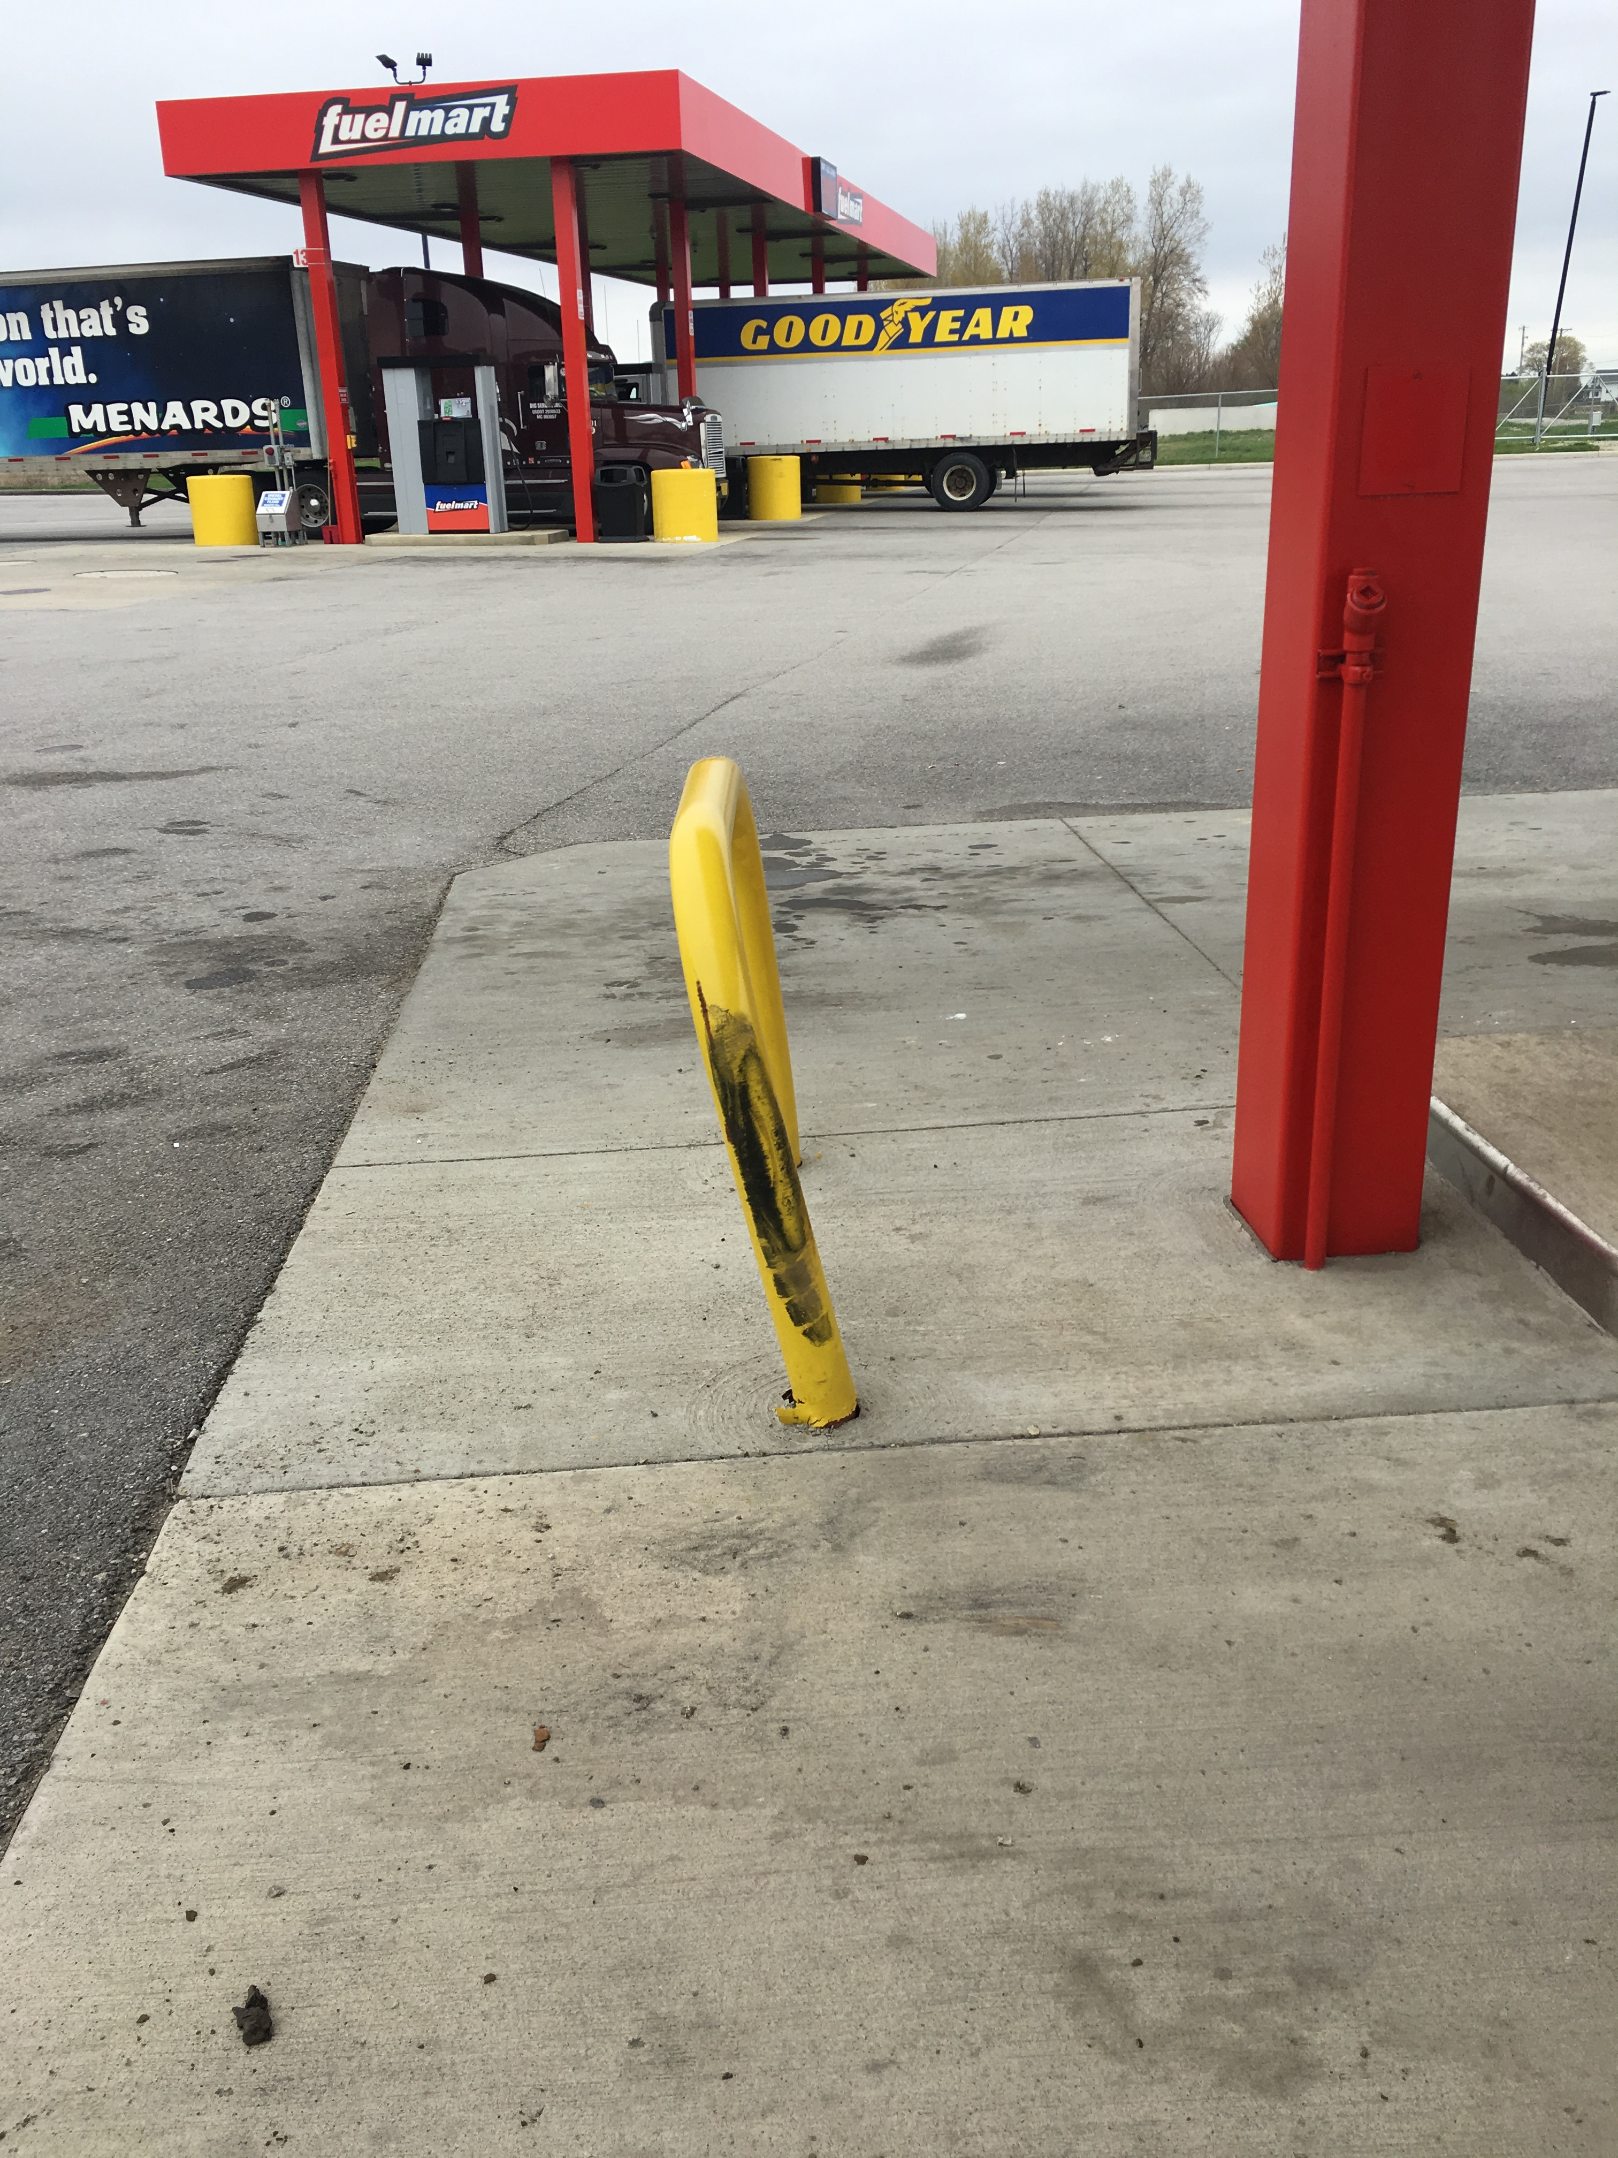
FM 767 Property Damage:
On 04/25/2019 a flatbed tow truck was pulling out of pump 11 & 12 and cut the turn too sharp. While making a right turn the passenger side quarter fender and rear tire struck the U-shaped bollard. FM damages include cracked concrete and the bollard is twisted. The quarter fender on the tow truck fell off. The driver stopped and picked up the quarter fender and drove off without reporting the damage to FM or his employer. FM noticed it and reported the incident to Phillip L. Phillip contacted the owner and the driver admitted to striking the bollard.

Slide 6
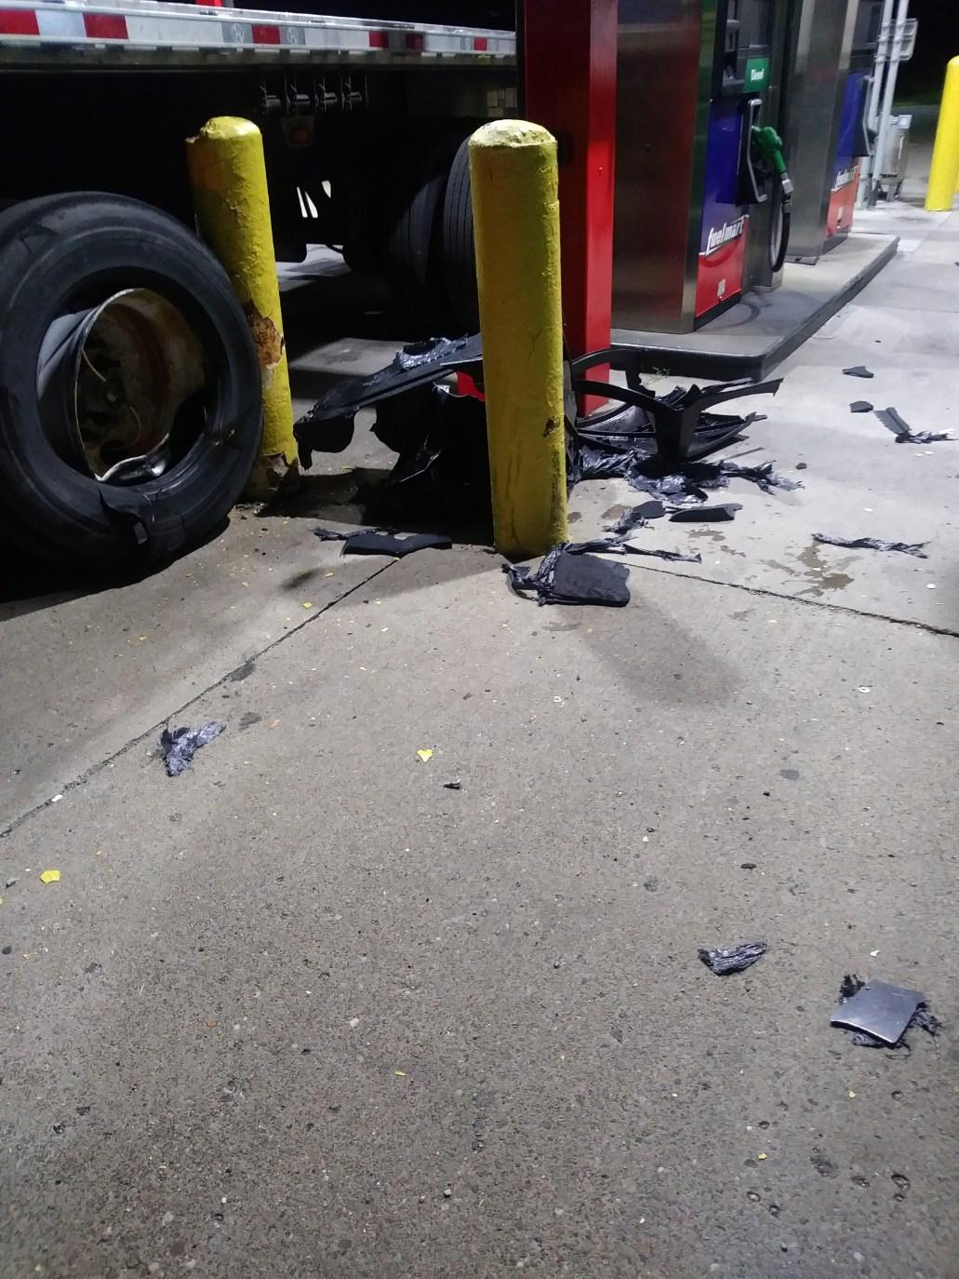
FM 727 Property Damage:
On 05/08/2019 a semi driver struck the bollard and trash can at pump 16 with the driver side trailer tire when he was pulling forward to leave the diesel island. The trash can is destroyed. The bollard sustained no damage other than some paint missing.

Slide 7
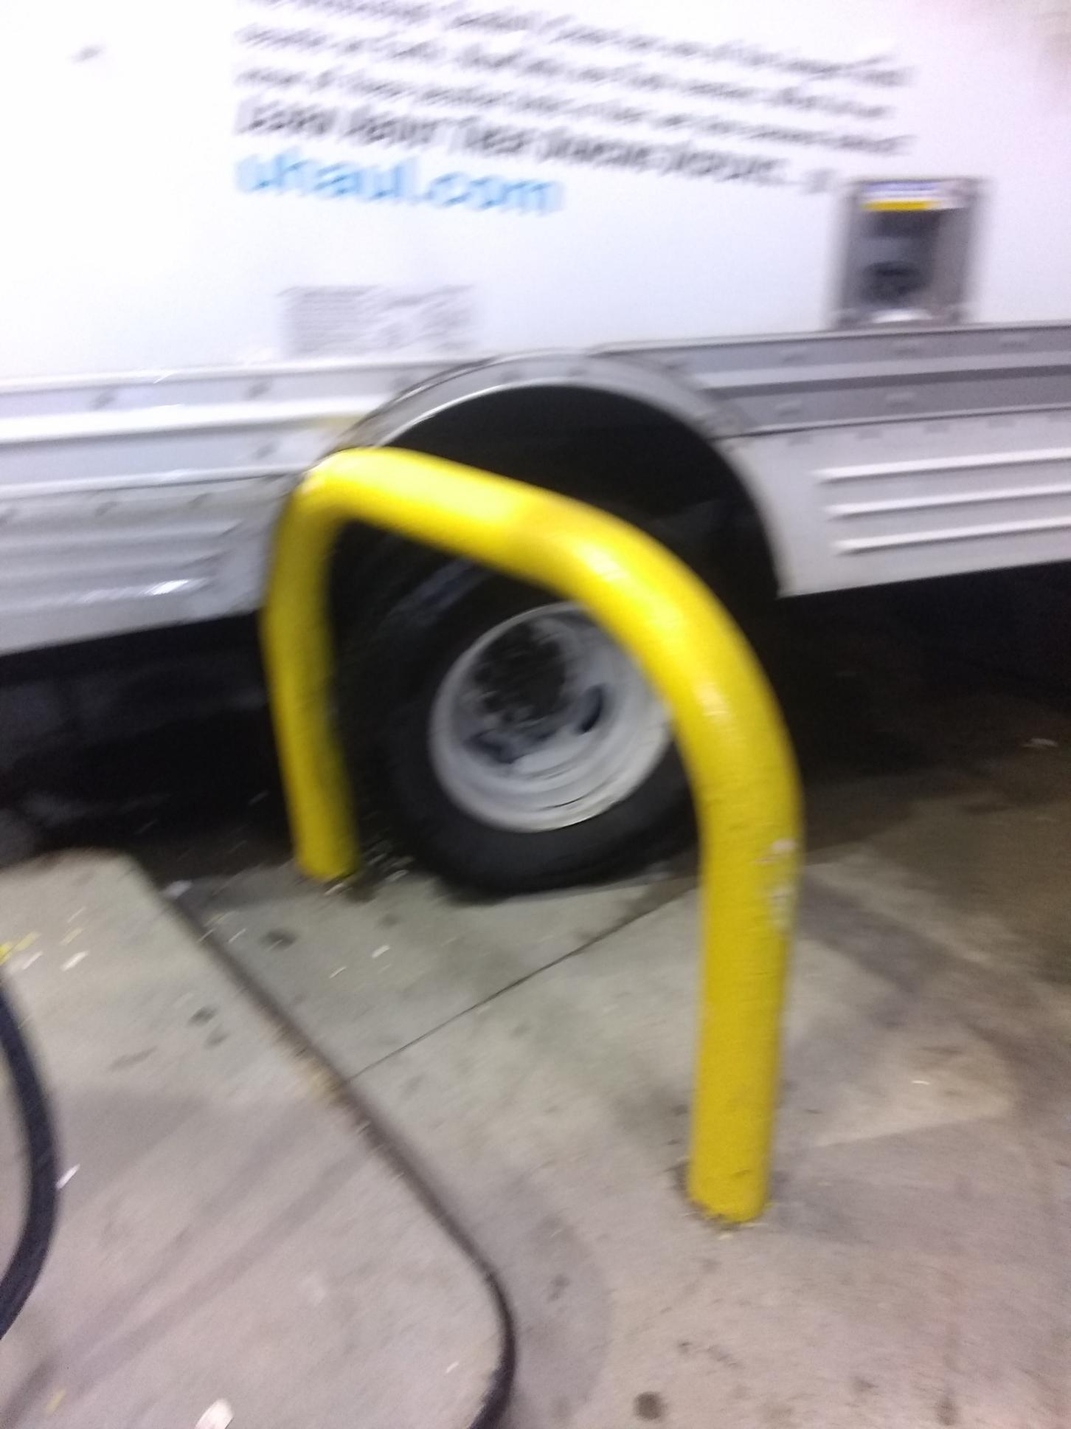
FM 706 Property Damage:
On 05/10/19 an individual driving a U-Haul was pulling forward from the pump and got the u-shaped bollard wedged between the rear tire and fender well.

Slide 8
FM customer Incidents:
05/08/2019 at FM 767 – a customer fell inside the store rolling their ankle and bruising both knees and elbow. The flooring was under construction with a rug laid over uneven surfaces (tiled and non-tiled area). The customer indicated she did not see the uneven surface under the rug and tripped and fell. FM has posted caution signs at each entrance and within the store to bring awareness to the construction and the uneven floor surfaces.

Slide 9
Date Range: Jan. 01, 2019 – May 12, 2019 Company Total Incidents: 65 FuelMart & Subway Total Incidents: 37 FuelMart & Subway employee injuries Reported: 10 FuelMart Property Damage and/or Vehicle Incidents: 9 FuelMart Customer Spills: 7 (5 at fuel pumps) FuelMart & Subway Customer injuries reported: 8 Other Incidents: 3

Slide 10
Safety Topics Heat Illness Prevention

Slide 11
Heat Exhaustion
Protecting Workers from Heat Stress
Exposure to heat can cause illness and death. The most serious heat illness is heat stroke. Other heat illnesses, such as heat exhaustion, heat cramps and heat rash, should also be avoided.
There are precautions that can be taken any time temperatures are high and the job involves physical work.

Slide 12
Risk Factors for Heat Illness
High temperature and humidity, direct sun exposure, no breeze or wind
Heavy physical labor
No recent exposure to hot workplaces
Low liquid intake
Waterproof clothing

Slide 13
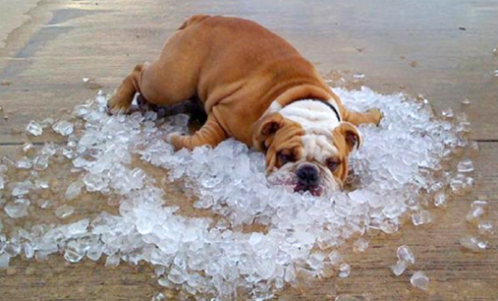
Symptoms of Heat Exhaustion
Headache, dizziness, or fainting
Weakness and wet skin
Irritability or confusion
Thirst, nausea, or vomiting

Slide 14
Symptoms of Heat Stroke
May be confused, unable to think clearly, pass out, collapse, or have seizures (fits)
May stop sweating

Slide 15
To Prevent Heat Illness:
Know signs/symptoms of heat illnesses; monitor yourself; use a buddy system.
• Block out direct sun and other heat sources.
• Drink plenty of fluids. Drink often and BEFORE you are thirsty. Drink water every 15 minutes.
• Avoid beverages containing alcohol or caffeine.

Slide 16
Open Floor Safety Questions / Concerns
Next Safety Committee Meeting is Wednesday, June 19, 2019 at 2:00 PM Eastern

